Slide 1
Bitcoin Price Prediction using Machine Learning
Yousof Mohajeranirad

Slide 2
Contents
Why to predict Bitcoin Price?
Methods
Dataset
Results
Conclusion

Slide 3
Why to predict Bitcoin Price? 1. Investment Attraction 2. Growing Role in the Global Economy (The increasing adoption of Bitcoin as a global financial reserve asset and its impacts on financial markets and domestic economies)
Objective
Using data mining methods and macroeconomic indicators to predict the price of Bitcoin.

Slide 4
1. Federal Reserve Interest Rate: The Federal Reserve interest rate, set by the U.S. central bank, plays a significant role in the attractiveness of investing in digital assets. When interest rates are high, investors tend to prefer risk-free assets like government bonds, which can reduce demand for Bitcoin. Conversely, low-interest rates often lead to increased investment in high-risk assets such as Bitcoin.
Macroeconomic Variables
2. Dollar Index: The Dollar Index reflects the value of the U.S. dollar relative to a group of major world currencies. The relationship between the value of the dollar and the price of Bitcoin is often inverse. When the dollar’s value increases, high-risk assets like Bitcoin may become less attractive. On the other hand, a decline in the dollar’s value can increase demand for Bitcoin, as investors seek alternatives to a weakening dollar.

Slide 5
3. Gold Price: Gold holds a special place as a safe asset during economic crises or financial uncertainty. However, the relationship between gold prices and Bitcoin is often inverse. During times when investors seek security, the tendency to buy gold increases, which can reduce demand for Bitcoin. On the other hand, when investors are looking for high-risk assets, Bitcoin may replace gold.
Macroeconomic Variables
4. Oil Price: Fluctuations in oil prices can have a direct impact on the global economy and, consequently, on the Bitcoin market. As one of the most important global energy sources, any change in oil prices can cause fluctuations in financial markets. Rising oil prices can increase inflation, which might drive investors toward assets like Bitcoin.

Slide 6
5. NASDAQ Index: The NASDAQ index is one of the primary benchmarks for stock market performance, especially in the technology sector. The correlation between traditional markets like NASDAQ and digital currencies can indicate investor sentiment. When traditional markets perform poorly, investors may seek new opportunities in the digital currency market, which can influence Bitcoin's price.
Macroeconomic Variables

Slide 7
Method: SVM
SVM stands for Support Vector Machine.
SVM is a type of supervised machine learning algorithm that is primarily used for classification but can also be applied to regression tasks. It works by finding the optimal hyperplane that separates data points into different classes with the maximum margin. SVM is effective in high-dimensional spaces and can handle non-linear relationships. Due to its robustness and ability to generalize well, it is utilized for predicting Bitcoin prices based on various features.

Slide 8
Methods: Decision Tree and Random Forest
Decision Tree
A Decision Tree is a type of machine learning model used for solving classification and regression problems. It operates as a tree-like structure where each node represents a condition on a feature, and each leaf represents an output (class or numerical value).
Due to its ability to split data based on various features, it is widely used in areas such as Bitcoin price prediction, disease diagnosis, and financial decision-making. This model is popular in machine learning due to its simple and interpretable structure.
Random Forest
A Random Forest is a collection of Decision Trees that are trained in parallel, and their results are combined to produce the final prediction. This model is based on the Bootstrap Aggregating method, which reduces the individual errors of each tree and improves overall accuracy.
Due to its ability to manage high-dimensional data and numerous features, it is widely used for Bitcoin price prediction and other data-driven applications.

Slide 9
Method: XGBoost
XGBoost stands for Extreme Gradient Boosting.
XGBoost is a type of machine learning algorithm that uses an ensemble of decision trees to make predictions. Due to its ability to handle complex relationships between features and prevent overfitting, it is widely used for predicting Bitcoin prices. It is a model that improves accuracy by combining the predictions of multiple weak models in a sequential manner.

Slide 10
Method: RNN
RNN stands for Recurrent Neural Network.
RNN is a type of deep neural network specifically designed for processing sequential and time-series data. RNN retains previous information in memory and uses it to process current data.
Application in Bitcoin Price Prediction:
RNN can be used to predict Bitcoin prices, especially when historical data includes short-term fluctuations. This model helps investors better understand price trends by identifying sequential dependencies.

Slide 11
Method: LSTM
LSTM stands for Long Short Term Memory.
LSTM is a type of deep neural network suitable for processing time-series data. Due to its ability to learn long term dependencies in historical data, it is widely used for predicting Bitcoin prices. It is a model that extends the memory of Recurrent Neural Networks (RNN), which is capable of learning long term dependencies.

Slide 12
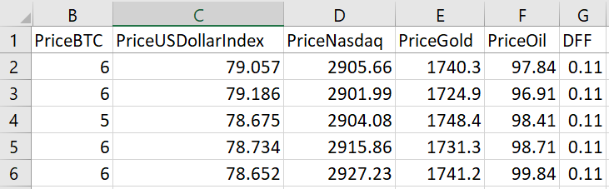
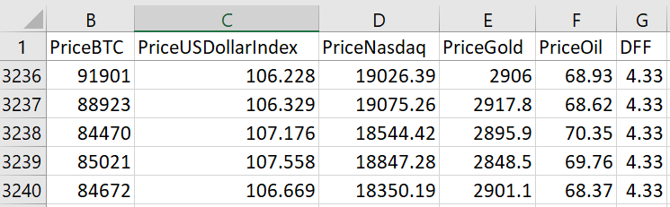
Dataset
2/2/2012 to 2/28/2025
Train Data: 95%
Test Data: 5%

Slide 13
Results
Method | Test r2_ score | Test MSE
Decision tree | 0.9918 | 0.0121
Random Forest | 0.9967 | 0.0048
XGBoost | 0.9956 | 0.0064
SVM | 0.9888 | 0.0164
RNN | 0.9822 | 0.0262
LSTM | 0.9894 | 0.0155

Slide 14
Prediction of Next Day
Method | Actual last Bitcoin Price | Predicted
Decision tree | 84672 | 90999
Random Forest |  | 85945
XGBoost |  | 85945
SVM |  | 84440
RNN |  | 80734
LSTM |  | 85997

Slide 15
Conclusion
The primary objective of this project was to predict Bitcoin prices using machine learning methods and macroeconomic indicators, such as the Federal Reserve interest rate, USD index, gold and oil prices, and the Nasdaq index.
The results demonstrated that the Random Forest model achieved the highest accuracy, with an R² score of 0.9967 and an MSE of 0.0048, highlighting its ability to capture complex patterns between macroeconomic variables and Bitcoin price fluctuations.
Other models, including XGBoost and LSTM, also performed well, underscoring the effectiveness of ensemble boosting methods and neural networks for time-series forecasting.

Slide 16
THANK YOU!

Slide 17
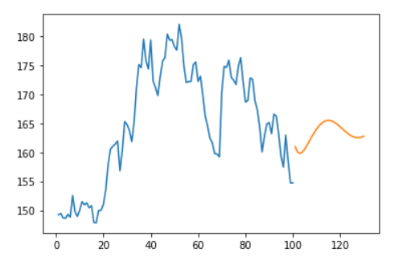
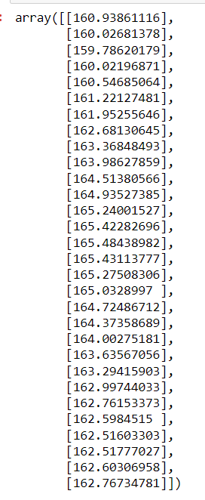
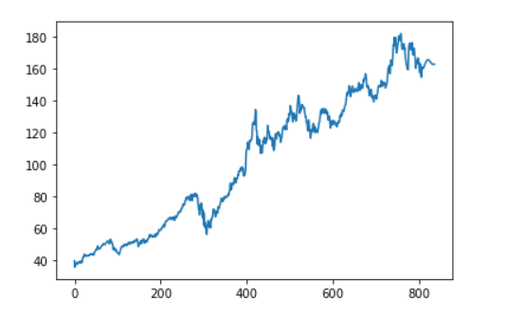
Prediction of Next 30 Days

Slide 18
References
Prashant Sharma, Machine Learning for Stock Market Prediction
(https://www.analyticsvidhya.com/blog/2021/10/machine-learning-for-stock-market-prediction-with-step-by-step-implementation/?custom=TwBL912)
Stock Price Prediction- Machine Learning
(https://data-flair.training/blogs/stock-price-prediction-machine-learning-project-in-python)
Stock Market Prediction using Machine Learning (https://www.mdpi.com/2079-9292/10/21/2717/pdf)
Avijeet Biswal, An Easy Guide to Stock Price Prediction Using Machine Learning
https://www.sciencedirect.com/science/article/pii/S1877050920307924
https://journalofbigdata.springeropen.com/articles/10.1186/s40537-020-00333-6

Slide 19
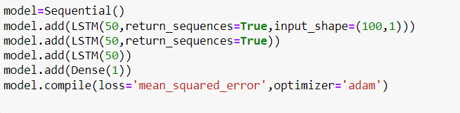
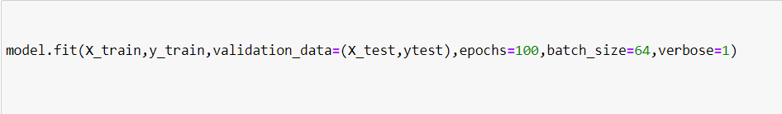
LSTM Model

